Slide 1
The peculiarities of polaron motion in the molecular polynucleotide chains of finite length in the presence of localized excitations in the chain
Additional materials to the article:
Korshunova A.N., Lakhno V.D.
Institute of Mathematical Problems of Biology

Slide 2
The numerical experiments which demonstrate the possibility of polaron charge transfer in a homogeneous finite unclosed G/C DNA chain due to the interaction with localized excitations have been carried out in the absence of an electric field. As a model, which describes the dynamics of a DNA molecule, was considered the Peyrard-Bishop-Holstein model. It is shown that, depending on the parameters of the selected initial excitations and on the parameters of the chain, the polaron can move over long distances (about a thousand sites). It is also shown that the ability of a polaron to move and the character of this movement significantly depend on the relative positions of the polaron and the selected localized excitations.

Slide 3
Mathematical model

Slide 4
The initial data

Slide 5
The initial data
Since there is friction in the chain, then n₀ may not coincide with the center of the chain, it is important that the polaron does not shift from its initial position under given friction and in the absence of excitations in the chain.
In the presented work, the initial polaron was placed in the center of the chain, in order to there was no questions about the causes of the polaron motion.
In the article:
  Korshunova A.N., Lakhno V.D.,
  Mathematical Biology & Bioinformatics, 2016, 11(2), 141-158.
  The Peculiarities of Polaron Motion in the Molecular
  Polynucleotide Chains of Finite Length. (published in Russian)
it was shown that the polaron placed at the initial moment of time not in the center of the chain, acquires the ability to move. In the referenced article the numerical simulation was also based the Peyrard-Bishop-Holstein model. Also in the referenced article were presented the numerical experiments which demonstrate the possibility of polaron charge transfer in a homogeneous finite unclosed G/C DNA chain in the absence of an electric field and additional excitations.

Slide 6
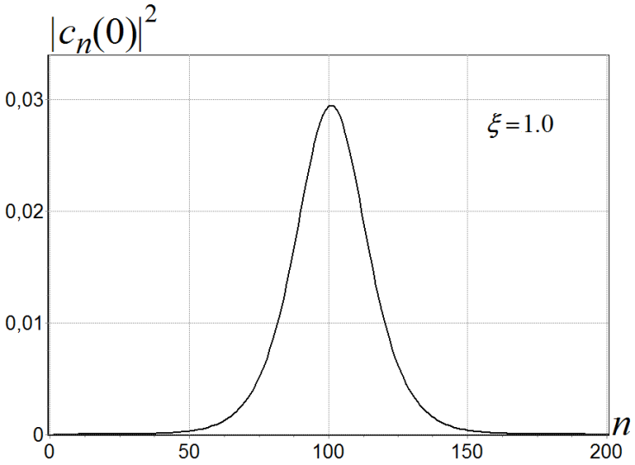
ξ - stretching coefficient, by means of which we can select an initial polaron
of the form (3) as close as possible to the steady polaron for any chain parameters.
This is the polaron corresponding to the stationary solution of equations (1), (2) with the following values of the parameters:
τ_{e}=18, χ_{el} =8.5, χ_{h}=0.5, ω_{bond} =0.2.
(parameter values are taken from work:
Lakhno V.D., Chetverikov A.P.,
Mathematical Biology & Bioinformatics,
2014, 9, №1, 4–19. (published in Russian))
For the above parameters of the chain, the value of the coefficient ξ = 1.
At such parameters of the chains in the PBH model, polaron located on a sufficiently large number of sites,
the characteristic size of this polaron =

Slide 7
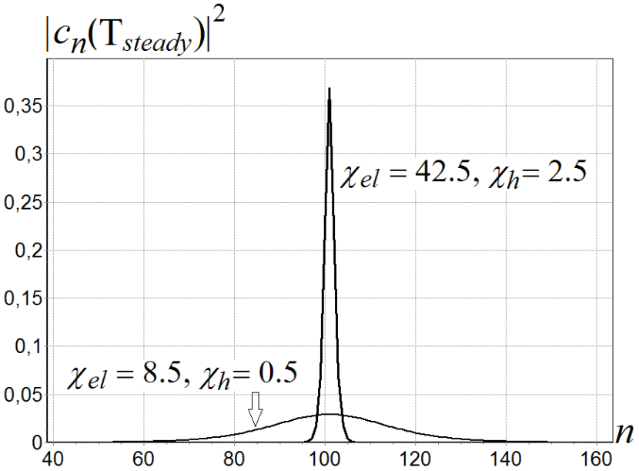
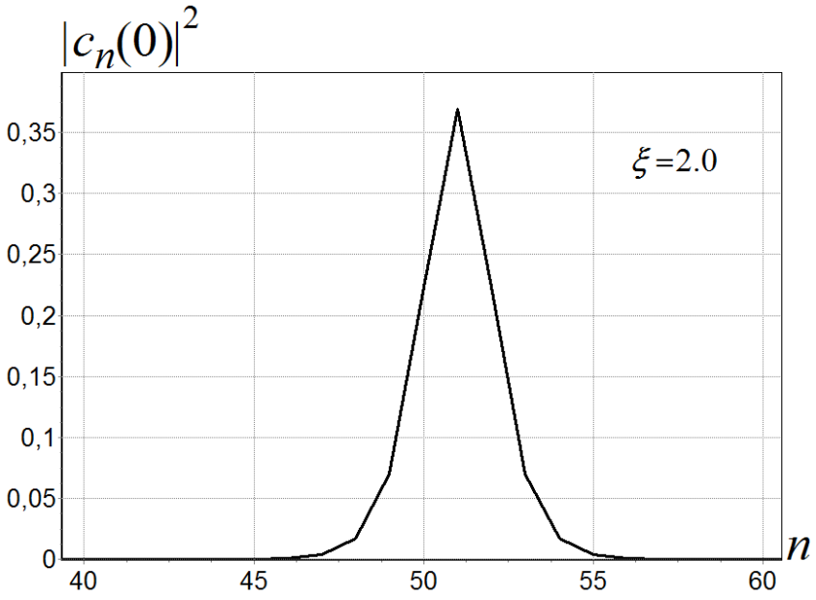
Steady polarons with the following
values of the parameters:
τ_{e}=18, χ_{el} =42.5, χ_{h}=2.5, ω_{bond} =0.2.
τ_{e}=18, χ_{el} =8.5, χ_{h}=0.5, ω_{bond} =0.2.
τ_{e}=18, χ_{el} =42.5, χ_{h}=2.5, ω_{bond} =0.2.
the characteristic size of such polaron =
For the above parameters of the chain, the value of the coefficient ξ = 2.

Slide 8
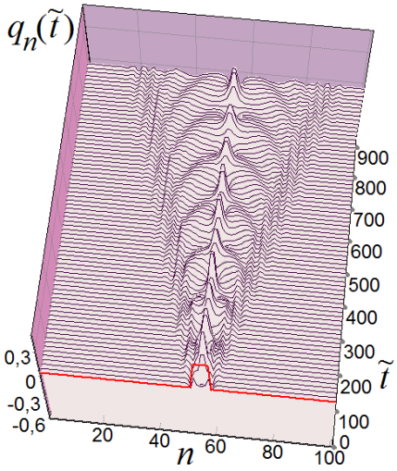
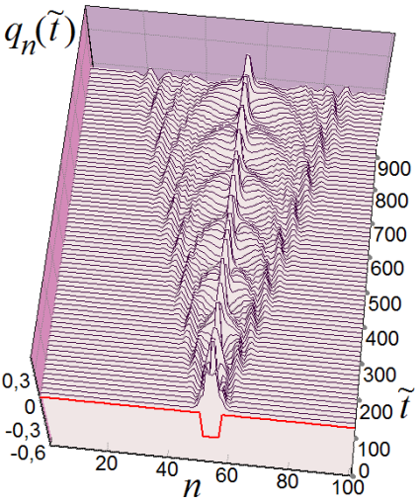
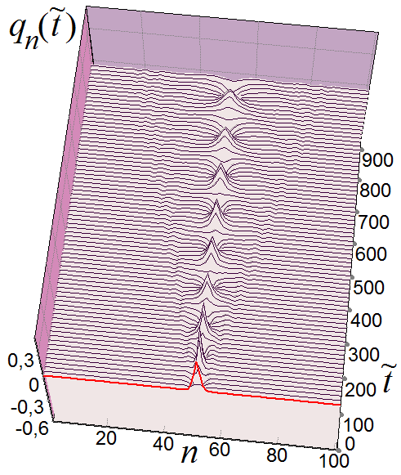

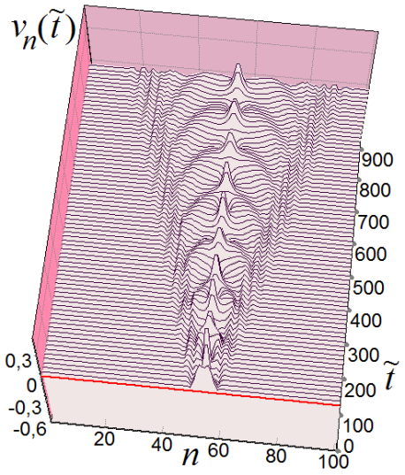
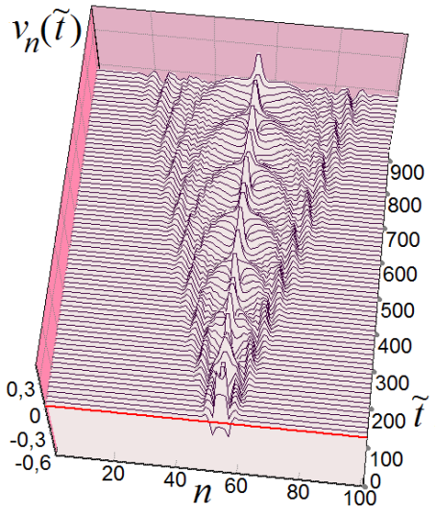
Examples of the localized excitations
in the absence of a polaron in the chain.
Chain length N=101 sites [1,101], center of the chain - site with number n=51
τ_{e}=18, χ_{el} =42.5, χ_{h}=0, ω_{bond} =0.2, Г=0.001
q₅₂₋₅₇(0)=0.3
q₅₂₋₅₇(0)= – 0.3
Denotement :
q_{n}(0) – has the form (3) with different signs for sites displacements formed
by the steady polaron in the chain

Slide 9

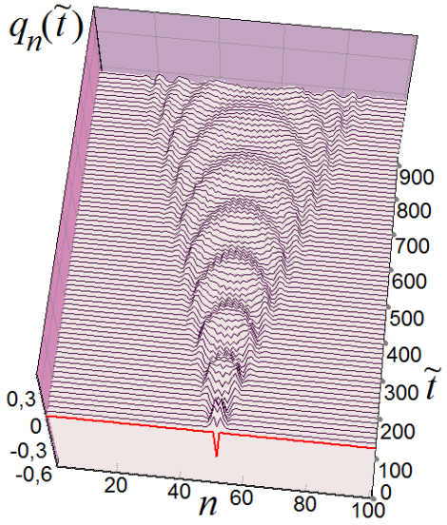

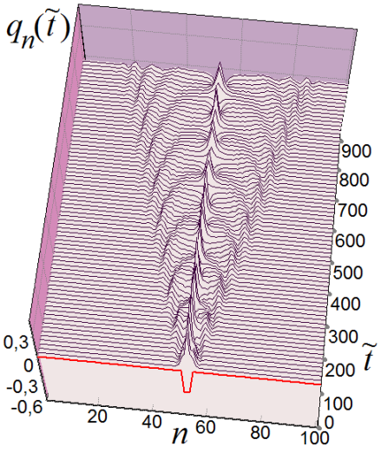
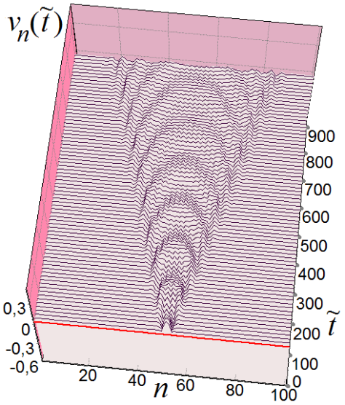
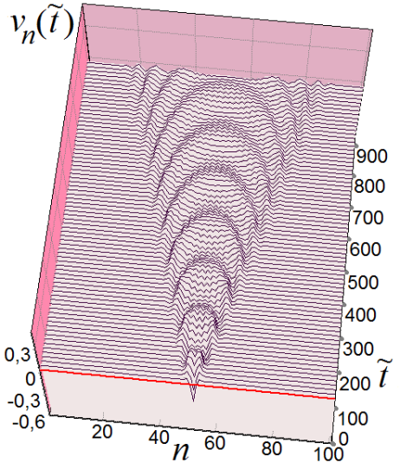

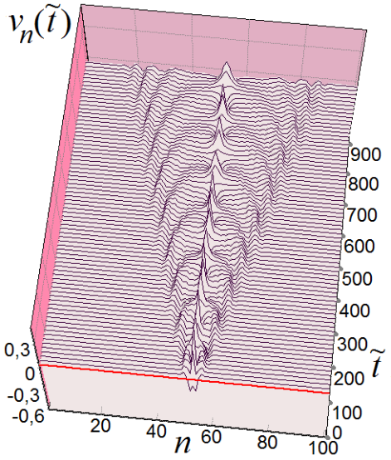
Examples of the localized excitations
in the absence of a polaron in the chain.
Chain length N=101 sites [1,101], center of the chain - site with number n=51
q₅₂(0) = 0.3
q₅₂(0) = – 0.3
q_{52,53,54}(0) = 0.3
q_{52,53,54}(0)= – 0.3

Slide 10

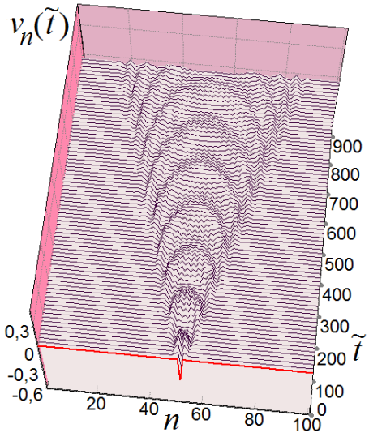





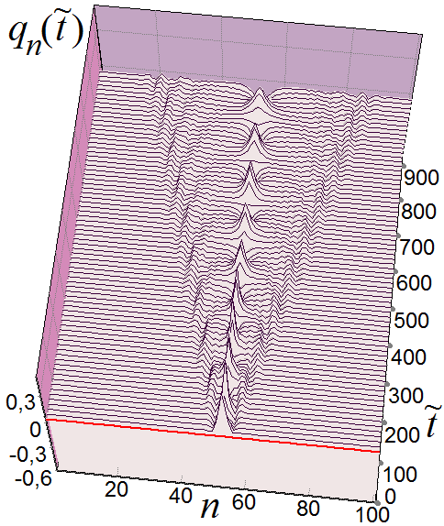
Examples of the localized excitations
in the absence of a polaron in the chain.
v₅₂(0) = 0.3
v₅₂(0) = – 0.3
v_{52,53,54}(0) = 0.3
v_{52,53,54}(0) = – 0.3

Slide 11
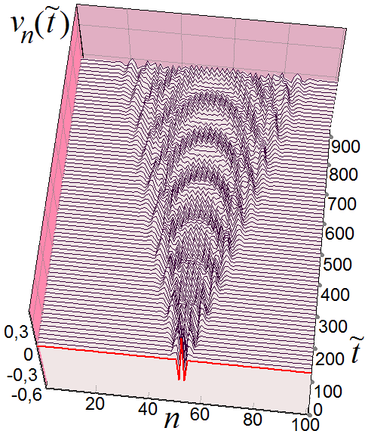
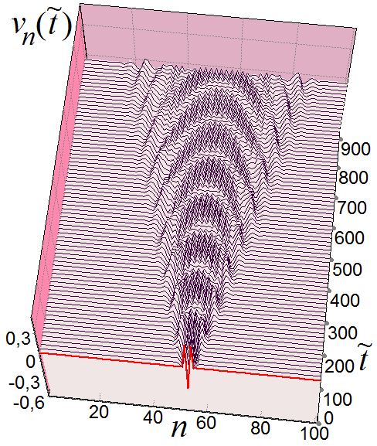
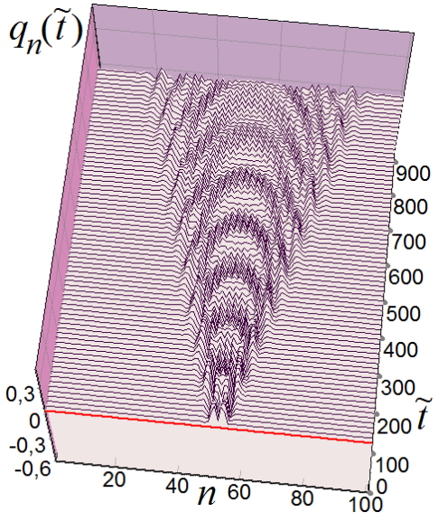
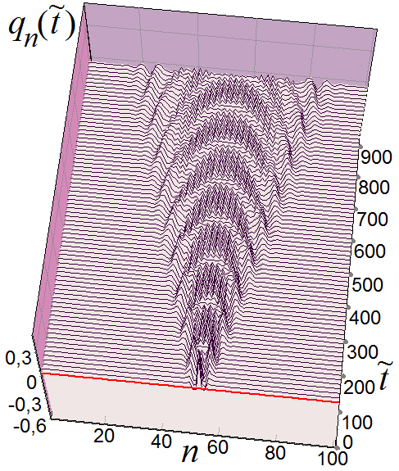
Examples of the localized excitations
in the absence of a polaron in the chain.
v_{52,54}(0)= – 0.3, v₅₃(0) = +0.3
v_{52,54}(0) = +0.3, v₅₃(0)= – 0.3
v_{52,53,54}(0)= – 0.3

Slide 12
Polaron motion in the homogeneous G/C DNA chain
in the presence of localized excitations in the chain, including breathers or bubbles.
n₀ = 51 ̶ coincides with the center of the chain.
Polaron of the form (3) which is close to the steady polaron under the following values of the parameters:
τ_{e}=18, χ_{el} =42.5, χ_{h}=2.5, ω_{bond} =0.2.,
the characteristic size of such polaron ≈ 4
For the above parameters of the chain, the value of the coefficient ξ = 2.
The following values will change: q_{n}(0) and v_{n}(0),

Slide 13
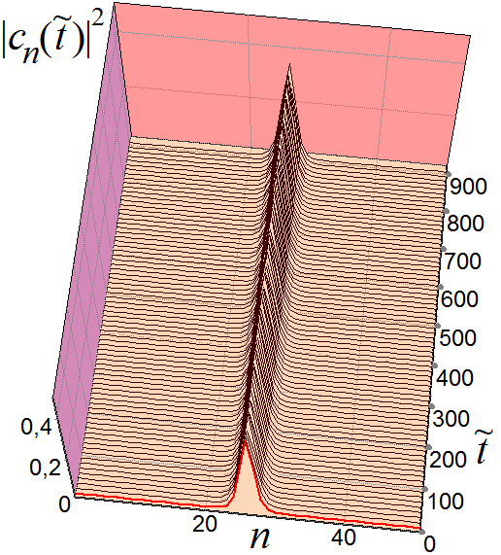
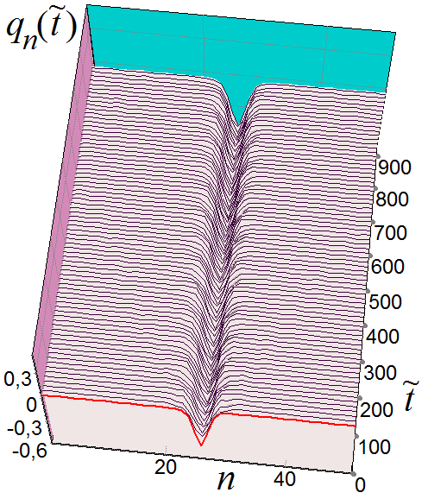
Example of a polaron in the absence
of the localized excitations in the chain.
The characteristic
size of such
polaron ≈ 4
The length of the chain is 51 sites.

Slide 14
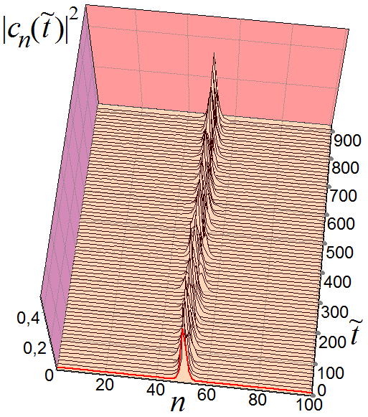
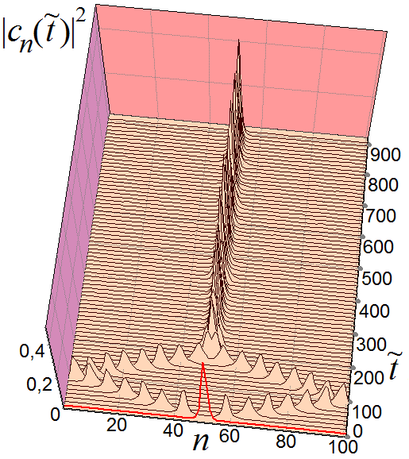
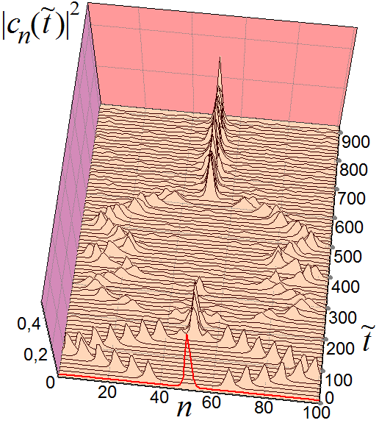
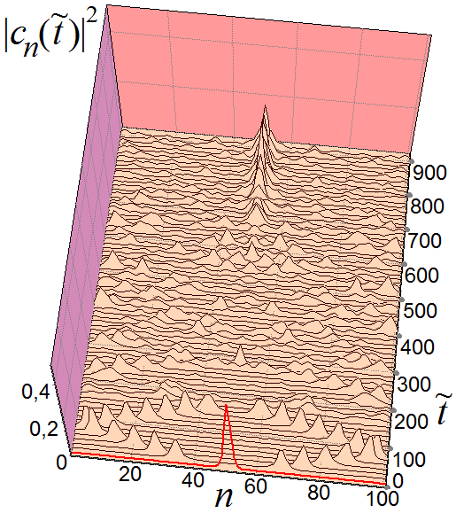
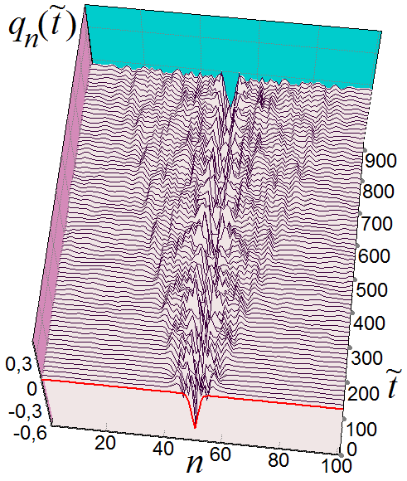
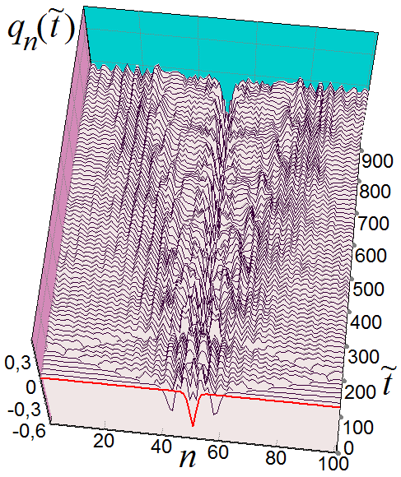
The behavior of the polaron in the presence
of localized excitations in the chain.
v₅₁(0)=0.9
v₅₁(0)=1.0
v₅₁(0)=1.1
v₅₁(0)=1.5
Chain length N=101 sites [1,101],
center of the chain - site with number n=51
At the initial time polaron is in the center of the chain.

Slide 15
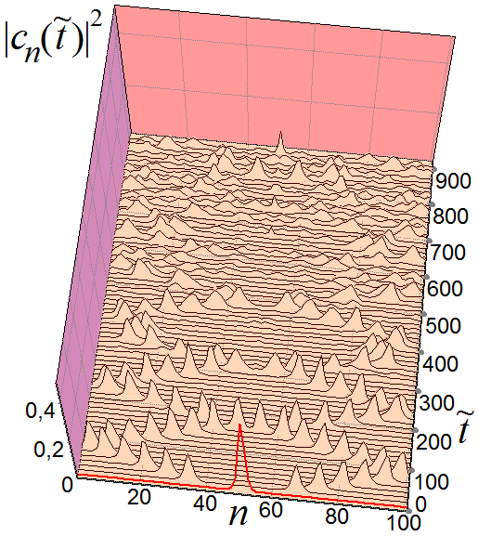
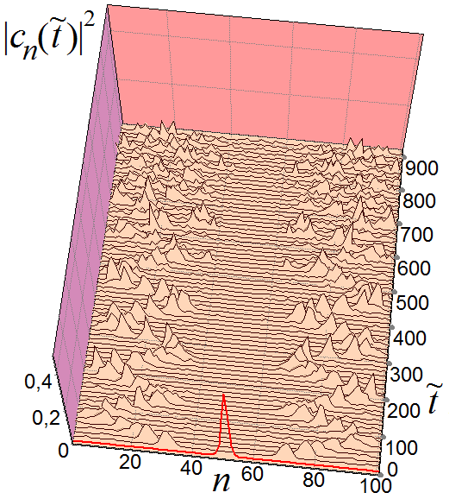
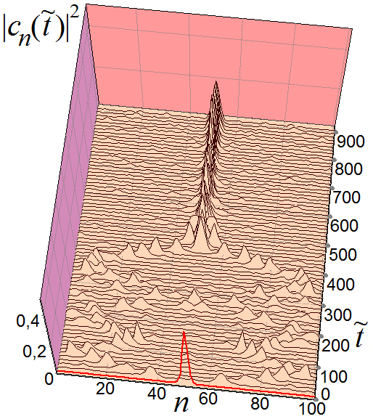
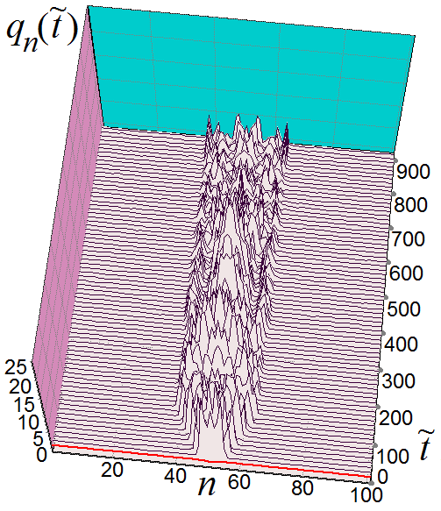
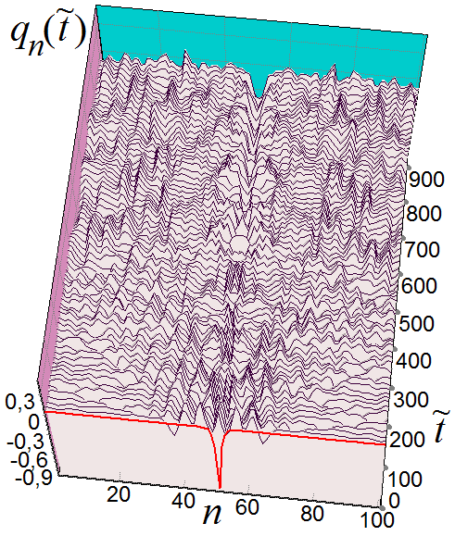
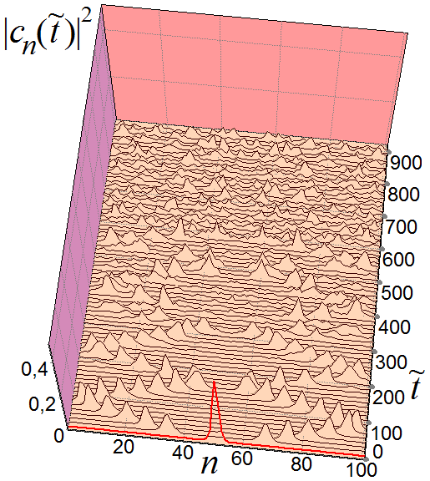
The behavior of the polaron in the presence
of localized excitations in the chain.
Chain length: N=101,
center of the chain: n=51
v₅₁(0) =2.0
v₅₁(0) =8.0
q₅₁(0) = – 1.0
v₅₁(0)=3.0
q₅₁(polaron) ≈ ̶ 0.46

Slide 16
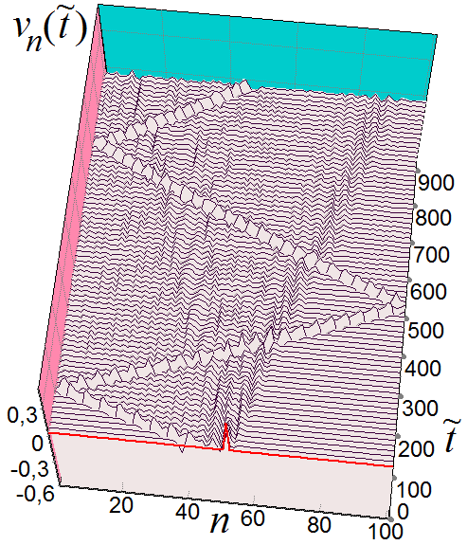
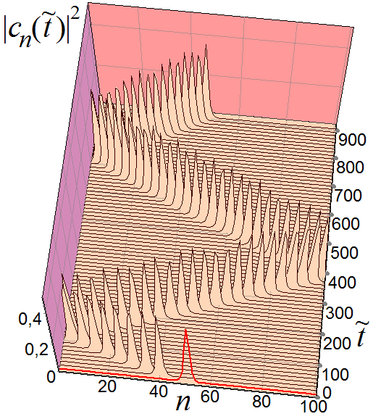
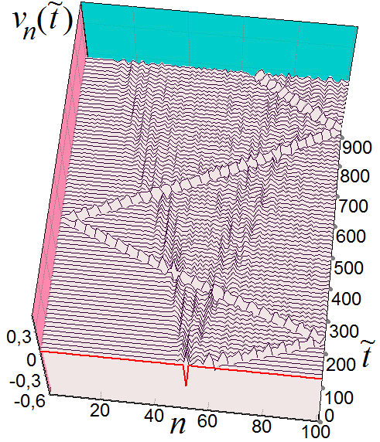
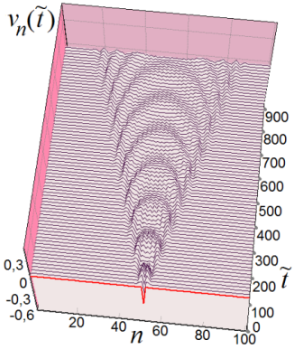

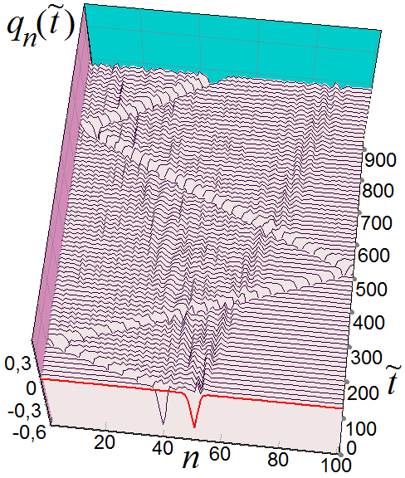
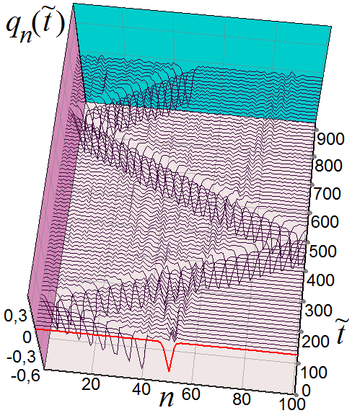
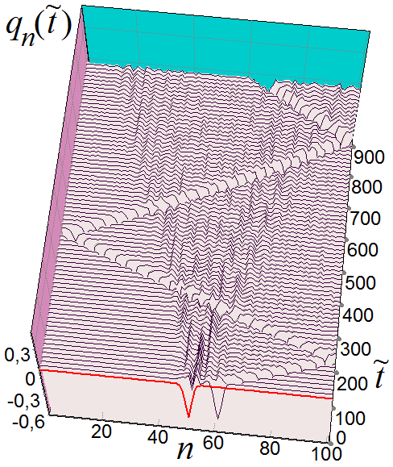
The motion of a polaron in the presence
of localized excitations in the chain.
Chain length: N=101,
center of the chain: n=51
v₅₂(0)= –0.3
v₅₂(0)=0.3

Slide 17
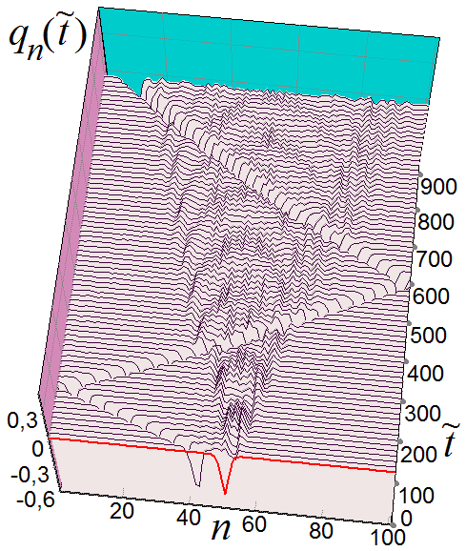

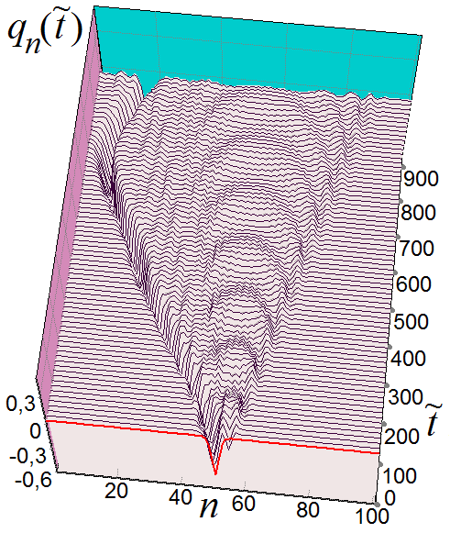
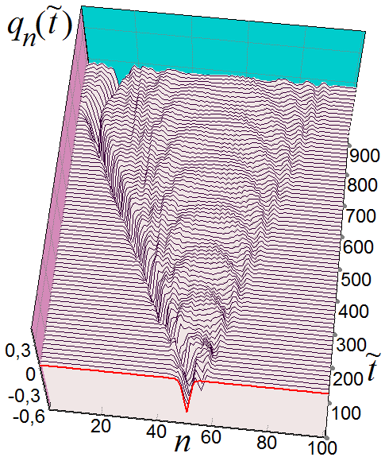
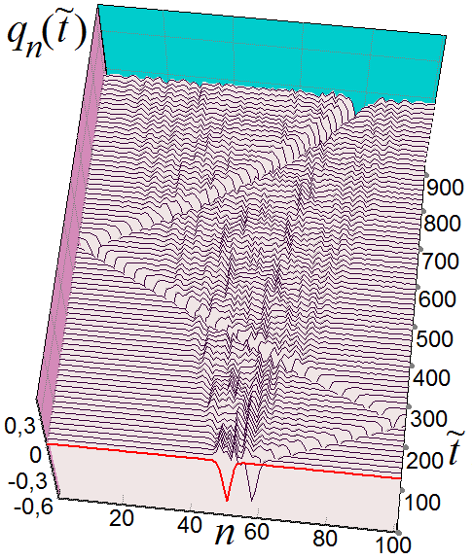
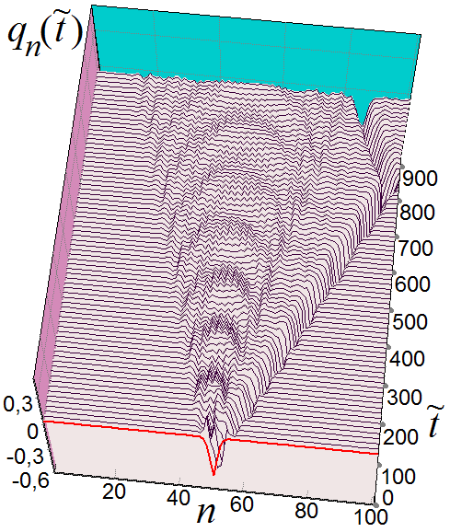

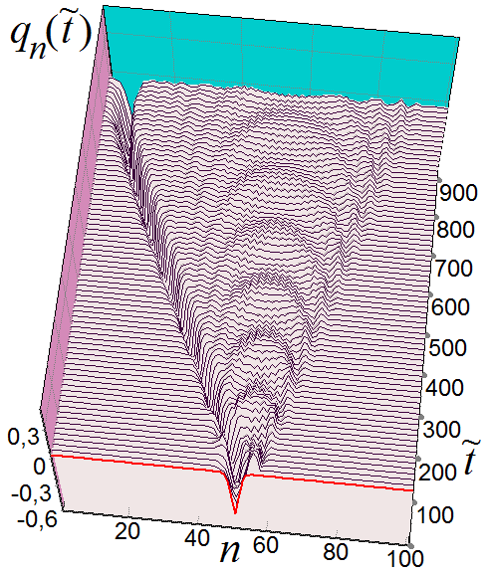
The motion of a polaron in the presence
of localized excitations in the chain.
Chain length: N=101,
center of the chain: n=51
v₅₃(0)=0.3
v₅₄(0)=0.3
v₅₅(0)=0.3
v₅₆(0)=0.3
v₅₃(0)= – 0.3
v₅₄(0)= – 0.3
v₅₅(0)= – 0.3
v₅₆(0)= – 0.3

Slide 18

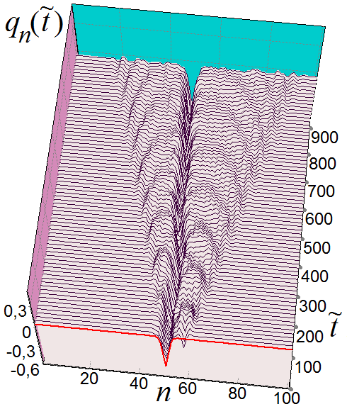
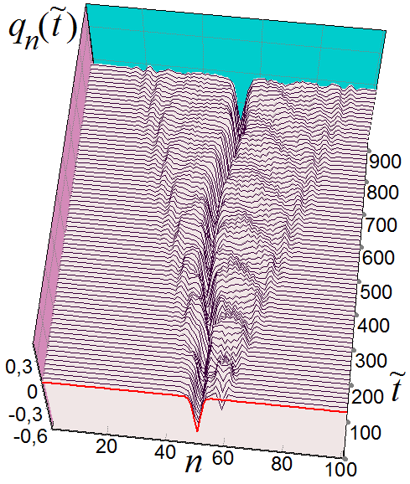
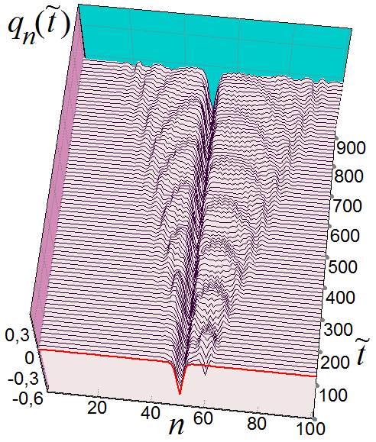
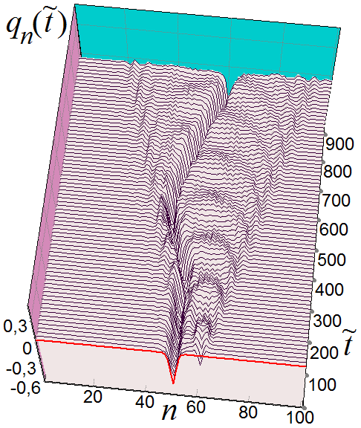



The motion of a polaron in the presence
of localized excitations in the chain.
Chain length: N=101,
center of the chain: n=51
v₅₇(0)=0.3
v₅₈(0)=0.3
v₅₉(0)=0.3
v₆₀(0)=0.3
v₆₁(0)=0.3
v₆₂(0)=0.3
v₆₄(0)=0.3
v₆₆(0)=0.3

Slide 19








The motion of a polaron in the presence
of localized excitations in the chain.
Chain length: N=101,
center of the chain: n=51
q₅₂(0) = q₅₁(0)
q₅₂(0) = q₅₃(0) = q₅₁(0)
q₅₂(0) = q₅₁(0) – 0.1
q₅₂(0) = q₅₁(0) – 0.2
q₅₂(0) = … =q₆₂(0)= 0.1
q₅₂₋₆₂(0)= 0.1*(–1)^{n}
q₅₆(0) = 0.3
q₅₆(0) = – 0.3

Slide 20








The motion of a polaron in the presence
of localized excitations in the chain.
Chain length: N=101,
center of the chain: n=51
Г=0.01
v₅₂(0)=0.6
v₅₄(0)=0.6
v₅₆(0)=0.6
v₅₈(0)=0.6
q₅₂(0)=0.6
q₅₃(0)=0.6
q₅₄(0)=0.6
q₅₅(0)=0.6

Slide 21








The motion of a polaron in the presence
of localized excitations in the chain.
Chain length: N=101,
center of the chain: n=51
Г=0.084
v₅₂(0)=1.0
v₅₃(0)=1.0
v₅₄(0)=1.0
v₅₅(0)=1.0
v₅₂(0)=2.0
v₅₂(0)=4.0
v₅₂(0)=6.0
v₅₂(0)=10.0

Slide 22

This is the polaron corresponding to the stationary solution of equations (1), (2) with the following values of the parameters:
τ_{e}=18, χ_{el} =8.5, χ_{h}=0.5, ω_{bond} =0.2.
For the above parameters of the chain,
the value of the coefficient ξ = 1.
At such parameters of the chains in the
PBH model, polaron located on a
sufficiently large number of sites,
the characteristic size of this polaron =

Slide 23



The motion of a wide polaron which has
a characteristic size about 52 sites
in the presence of localized excitations in the chain.
Chain length: N=301,
center of the chain: n=151
Г=0.01
v₁₅₂₋₂₀₂(0) = 0.01*(–1)^{n}
v₁₅₂₋₂₀₂(0) = 0.05*(–1)^{n}

Slide 24





The motion of a wide polaron which has
a characteristic size about 52 sites
in the presence of localized excitations in the chain.
Chain length: N=301,
center of the chain: n=151
Г=0.01
v₁₅₂₋₁₆₂(0) = 0.05*(–1)^{n}
v₁₆₂₋₁₇₂(0) = 0.05*(–1)^{n}
v₁₇₂₋₁₈₂(0) = 0.05*(–1)^{n}
v₁₈₂₋₁₉₂(0) = 0.05*(–1)^{n}
v₂₀₂₋₂₁₂(0) = 0.05*(–1)^{n}

Slide 25






The motion of a wide polaron which has
a characteristic size about 52 sites
in the presence of localized excitations in the chain.
Chain length: N=301,
center of the chain: n=151
Г=0.001
v₁₅₂(0)=0.05
v₁₅₂₋₂₀₂(0) = 0.05*(–1)^{n}
q₁₅₂(0) = … =q₂₀₂(0)= 0.005

